Slide 1

Chapter 6: Boolean Types

Slide 2
Boolean Types
Don't exist at assembly/machine level
Can simulate with 1/0 values:
true: .EQUATE 1
false: .EQUATE 0

Slide 3
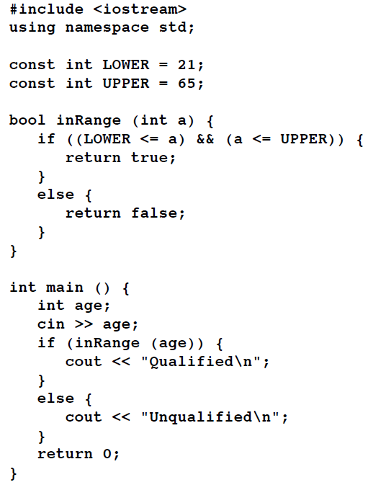
Boolean Example

Slide 4
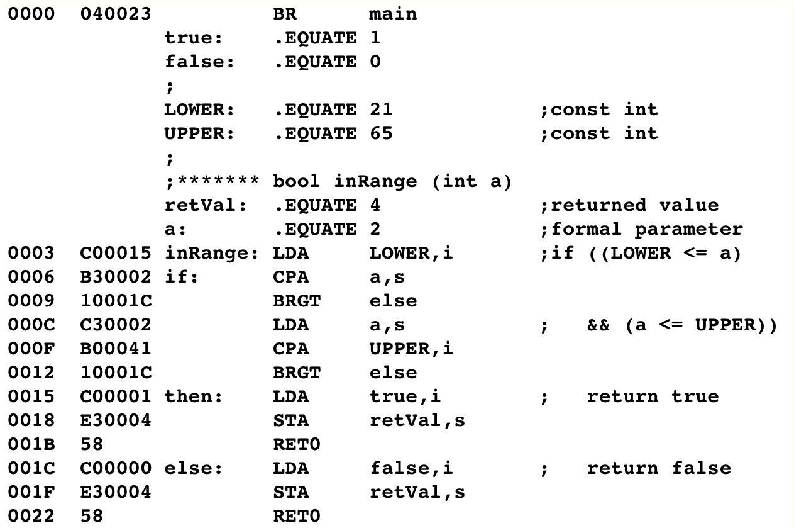
Boolean Example

Slide 5
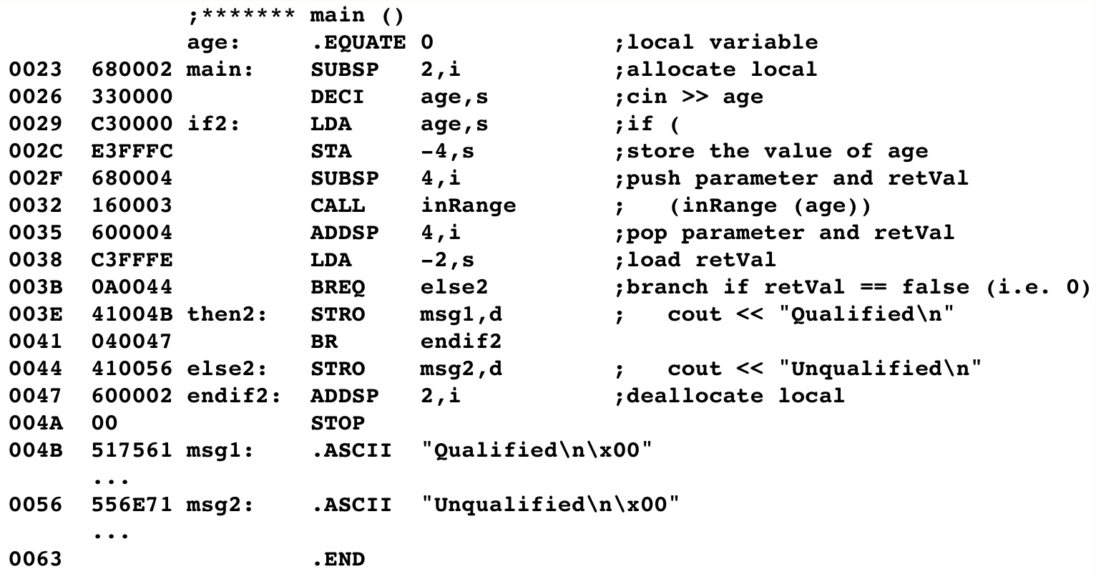
Boolean Example

